Slide 1
Text Generation with Exemplar-based Adaptive Decoding
Hao Peng, Ankur P. Parikh, Manaal Faruqui, Bhuwan Dhingra, Dipanjan Das
NAACL 2019
Reporter: Lu Shuai
2019.5.22

Slide 2
Introduction
Conditional text generation: text summarization, machine translation, and data-to-text generation
Encoder-decoder is capable of generating fluent abstractive text, but in an uncontrolled and sometimes unreliable way, often producing degenerate outputs and favoring generic utterances.
Earlier template-based method: the source content is filled into the slots of a handcrafted template. lack the naturalness, less scalable

Slide 3
Introduction
It draws inspiration from traditional template-based text generation techniques, where the source provides the content(i.e., what to say), and the template influences how to say it.
Use similar training samples as exemplars, to guide the decoding process -- exemplar-based adaptive decoding, where a customized decoder is constructed for each exemplar.

Slide 4
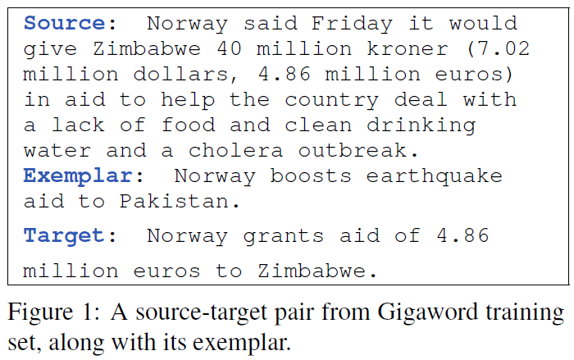
Introduction

Slide 5
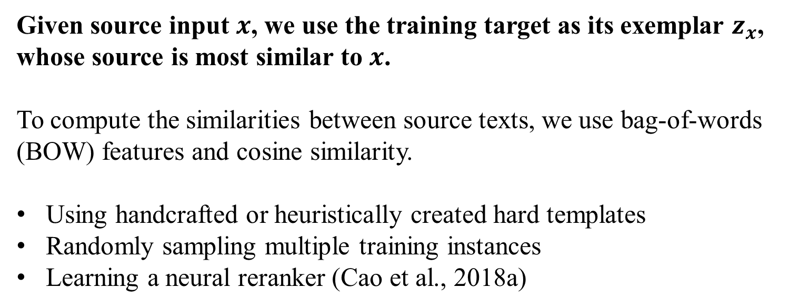
Retrieving exemplars
Given source input $x$, we use the training target as its exemplar $z_{x}$, whose source is most similar to $x$.
To compute the similarities between source texts, we use bag-of-words (BOW) features and cosine similarity.
Using handcrafted or heuristically created hard templates
Randomly sampling multiple training instances
Learning a neural reranker (Cao et al., 2018a)
Cao Z, Li W, Li S, et al. Retrieve, rerank and rewrite: Soft template based neural summarization[C]//Proceedings of the 56th Annual Meeting of the Association for Computational Linguistics (Volume 1: Long Papers). 2018: 152-161.

Slide 6
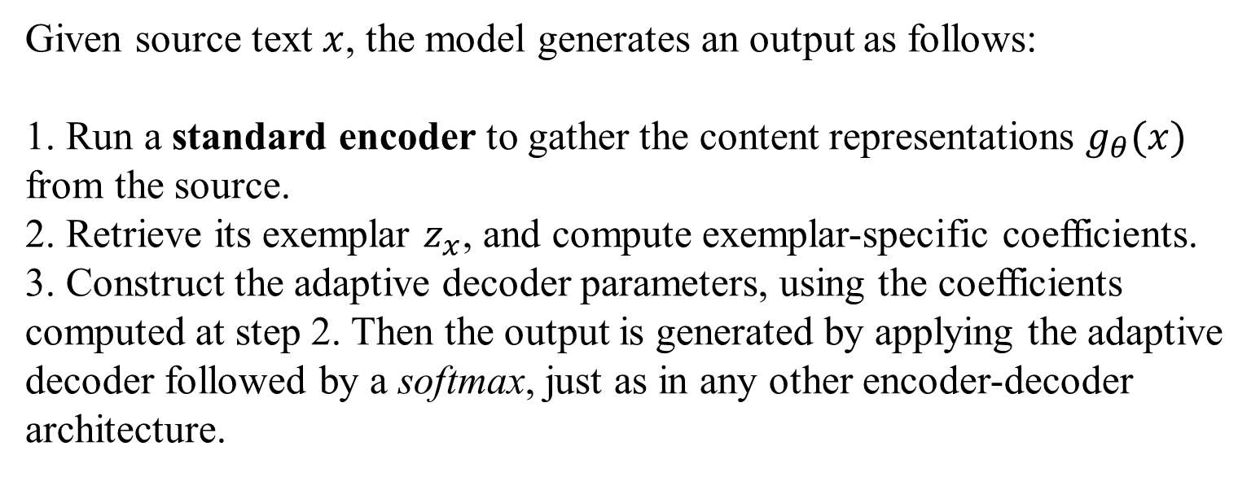
Method
Given source text $x$, the model generates an output as follows:
1. Run a standard encoder to gather the content representations $g_{θ}(x)$ from the source.
2. Retrieve its exemplar $z_{x}$, and compute exemplar-specific coefficients.
3. Construct the adaptive decoder parameters, using the coefficients computed at step 2. Then the output is generated by applying the adaptive decoder followed by a softmax, just as in any other encoder-decoder architecture.

Slide 7
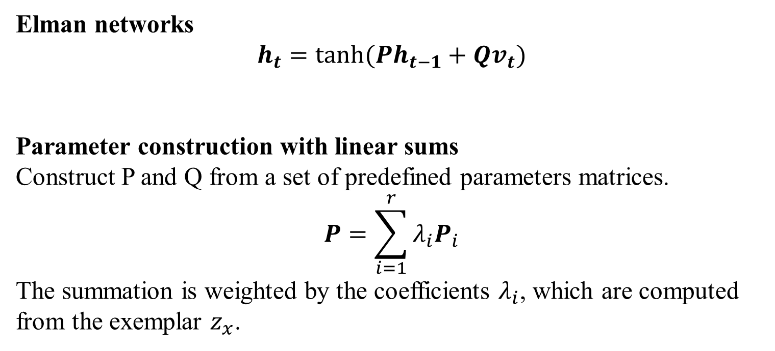
Step 3: Reparameterizing the RNN Decoder
Elman networks
$$h_{t}=tanh⁡(Ph_{t−1}+Qv_{t})$$
Parameter construction with linear sums
Construct P and Q from a set of predefined parameters matrices.
$$P=\sum_{i=1}^{r}{λ_{i}P_{i}}$$
The summation is weighted by the coefficients $λ_{i}$, which are computed from the exemplar $z_{x}$.
Notes:
关于模型的讨论建立在elman network之上，但是实现中用的是LSTM

Slide 8
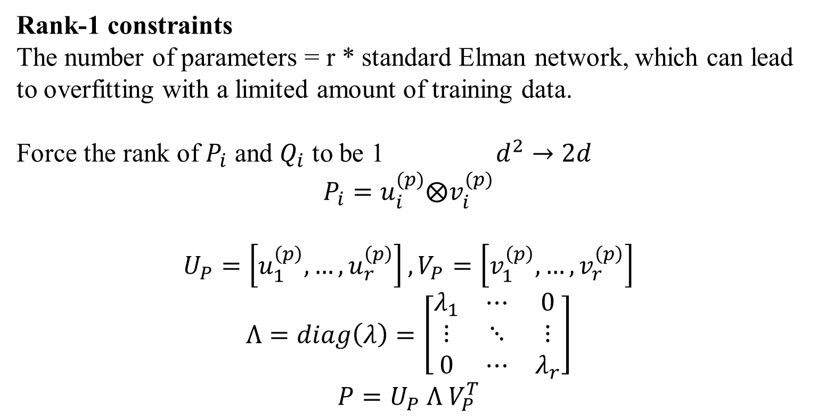
Step 3: Reparameterizing the RNN Decoder
Rank-1 constraints
The number of parameters = r * standard Elman network, which can lead to overfitting with a limited amount of training data.
Force the rank of $P_{i}$ and $Q_{i}$ to be 1 $d^{2}→2d$
$$P_{i}=u_{i}^{(p)}⨂v_{i}^{(p)}$$
$$U_{P}=\left[u_{1}^{\left(p\right)},…,u_{r}^{\left(p\right)}\right], V_{P}=\left[v_{1}^{\left(p\right)},…,v_{r}^{\left(p\right)}\right]$$
$$Λ=diag\left(λ\right)=\left[\begin{matrix}λ_{1} & ⋯ & 0 \\ ⋮ & ⋱ & ⋮ \\ 0 & ⋯ & λ_{r}\end{matrix}\right]$$
$$P=U_{P} Λ V_{P}^{T}$$

Slide 9
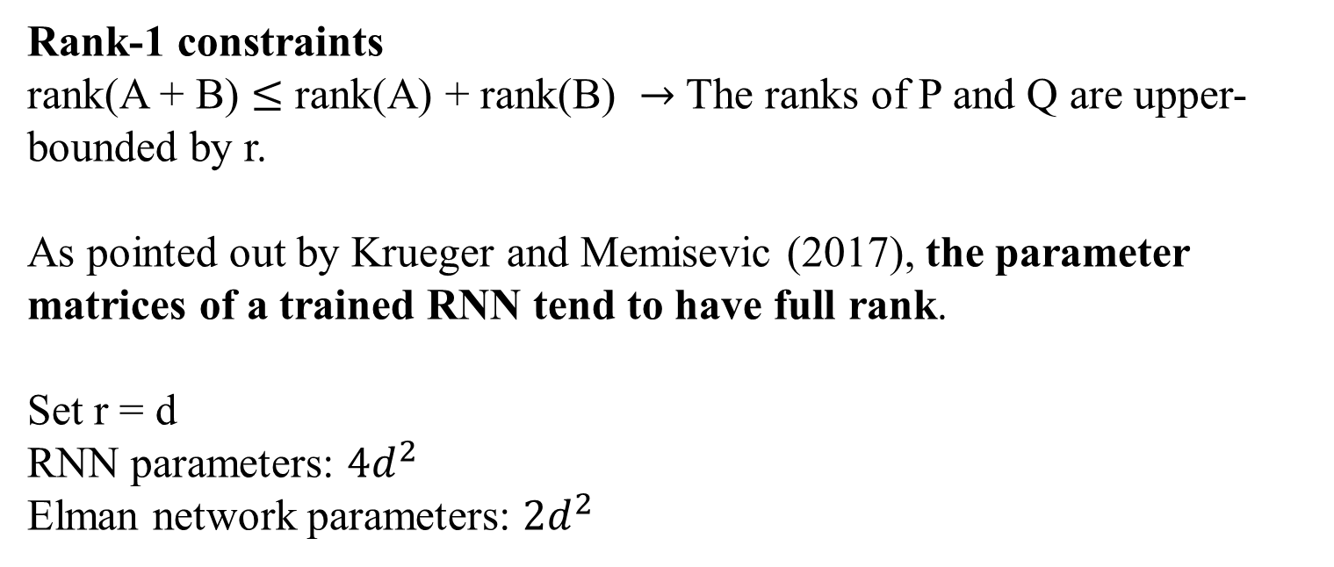
Step 3: Reparameterizing the RNN Decoder
Rank-1 constraints
rank(A + B) $≤$ rank(A) + rank(B) $→$The ranks of P and Q are upper-bounded by r.
As pointed out by Krueger and Memisevic (2017), the parameter matrices of a trained RNN tend to have full rank.
Set r = d
RNN parameters: $4d^{2}$
Elman network parameters: $2d^{2}$

Slide 10
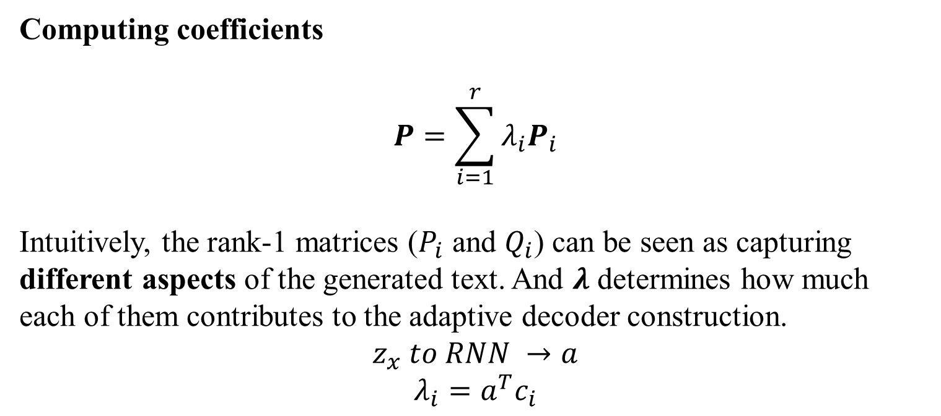
Step 2: Incorporating Exemplars
Computing coefficients
$$P=\sum_{i=1}^{r}{λ_{i}P_{i}}$$
Intuitively, the rank-1 matrices ($P_{i}$ and $Q_{i}$) can be seen as capturing different aspects of the generated text. And $λ$ determines how much each of them contributes to the adaptive decoder construction.
$$z_{x} to RNN →a$$
$$λ_{i}=a^{T}c_{i}$$

Slide 11
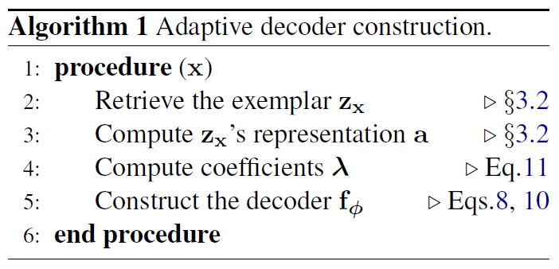
Method

Slide 12
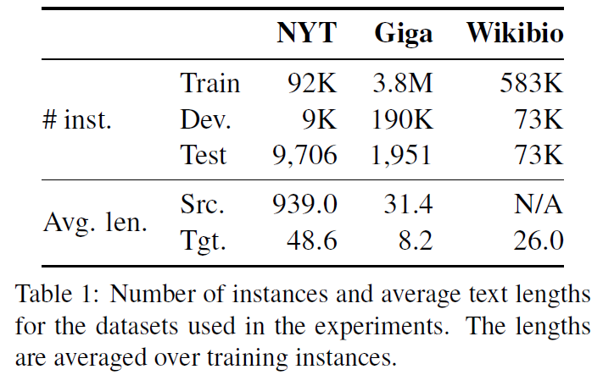
Experiments

Slide 13
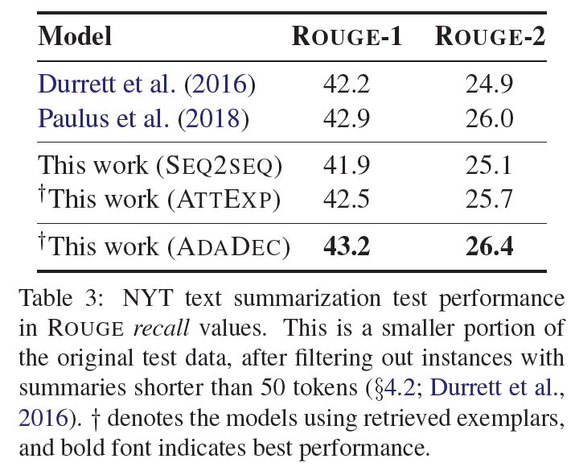
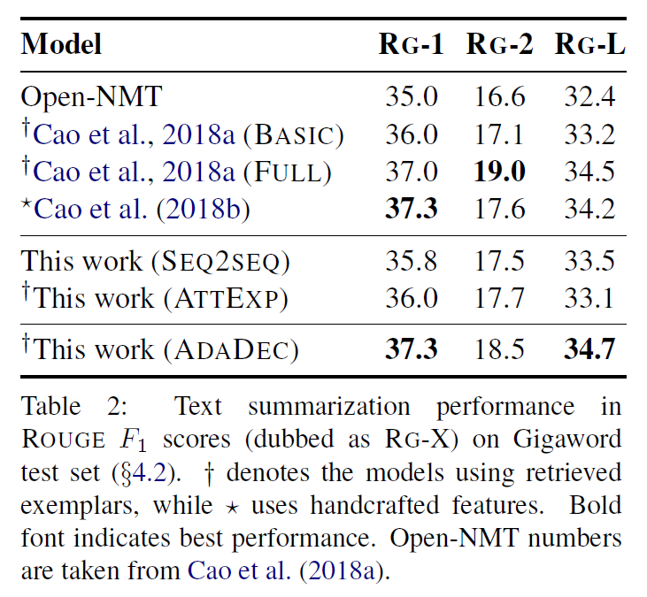
Experiments
ATTEXP: It is based on SEQ2SEQ. It encodes, attends over, and copies from the exemplars, in addition to the source inputs.
Notes:
Cao uses extensive handcrafted features and relies on external information extraction and syntactic parsing systems

Slide 14
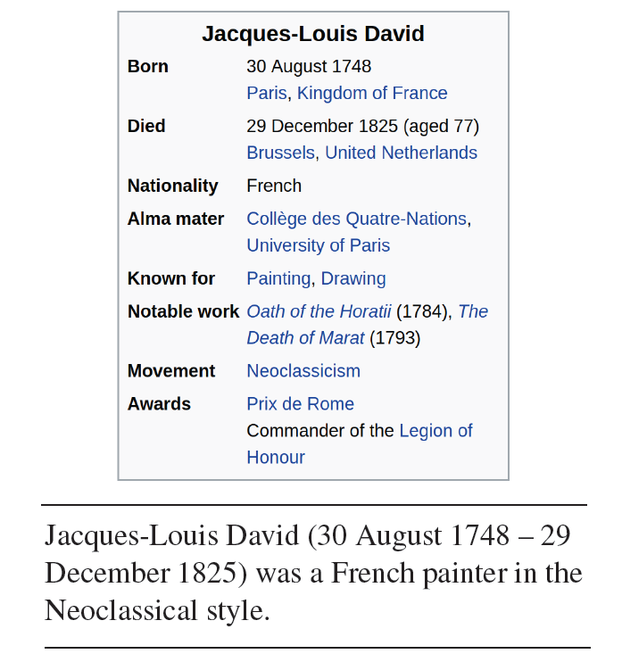
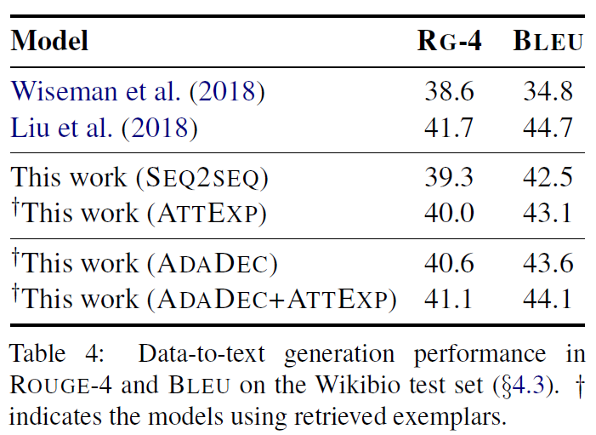
Experiments
To some extend, the ways ATTEXP and ADADEC incorporate exemplar information might be complementary.
Notes:
using (a) position and filed embeddings, and (b) structure-aware attention and gating techniques.

Slide 15
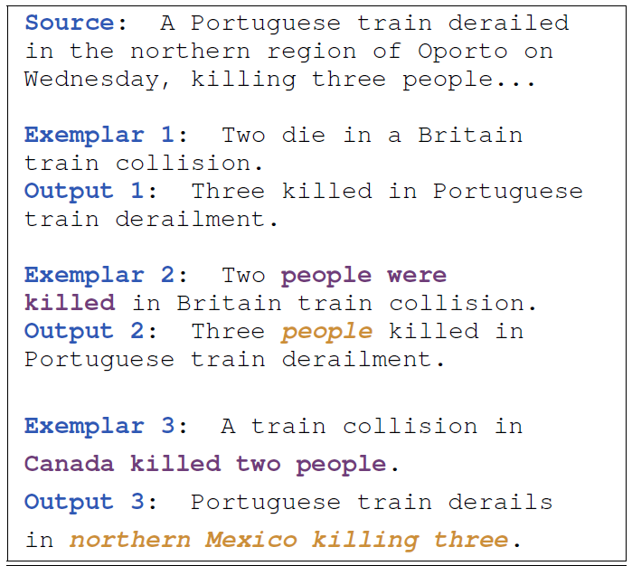
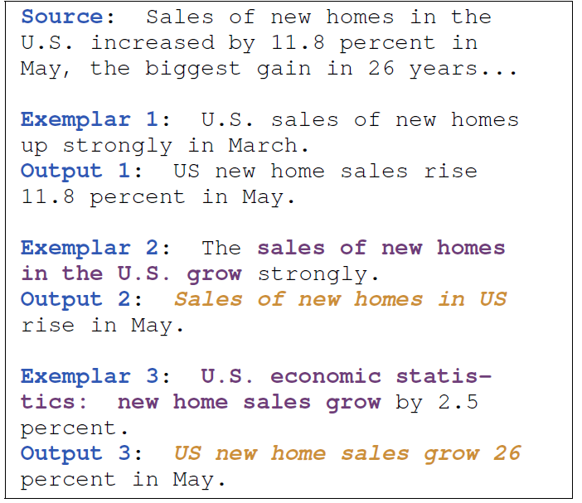
Analysis

Slide 16
Conclusion
Exemplar-based generation
Dynamic parameter construction

